Slide 1
Talk 21: Triumph of Capital Part Three

Slide 2
“Consequential” Election of 1896
McKinley, 54 years old
….solid, conservative, safe
Bryan, 36 years old
… passionate, Radical, different
…”free silver”…unlimited purchases
Republicans
Gold Standard
Big business
Pro immigration
Empire
Democrats
Silver/ Gold
Regulation
Anti immigration
Anti Empire

Slide 3
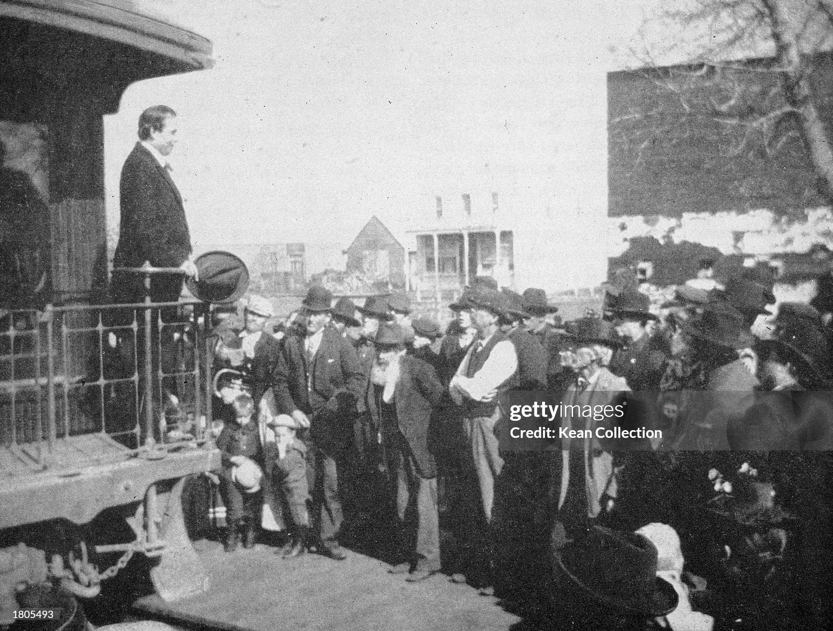
Bryan campaign across US

Slide 4
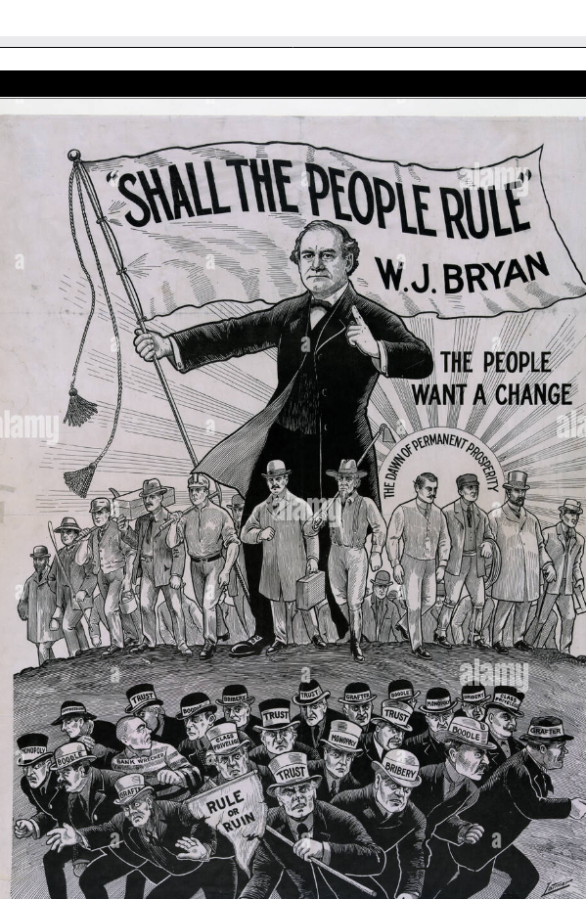
Pro Bryan Poster….”rule by the People!”

Slide 5
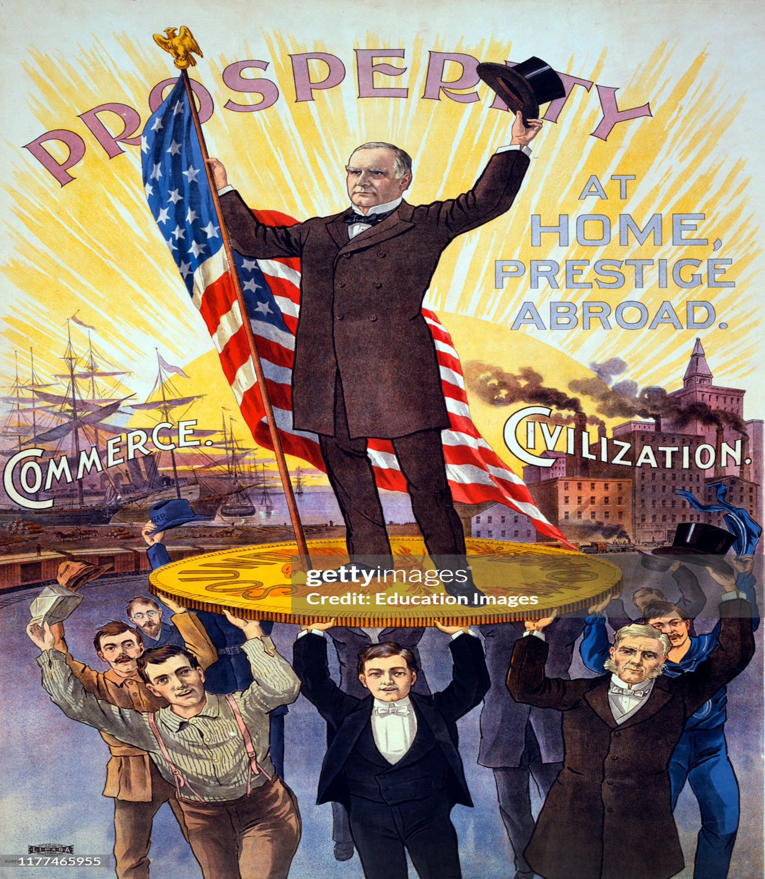
McKinley….patriotism, Empire, safety

Slide 6
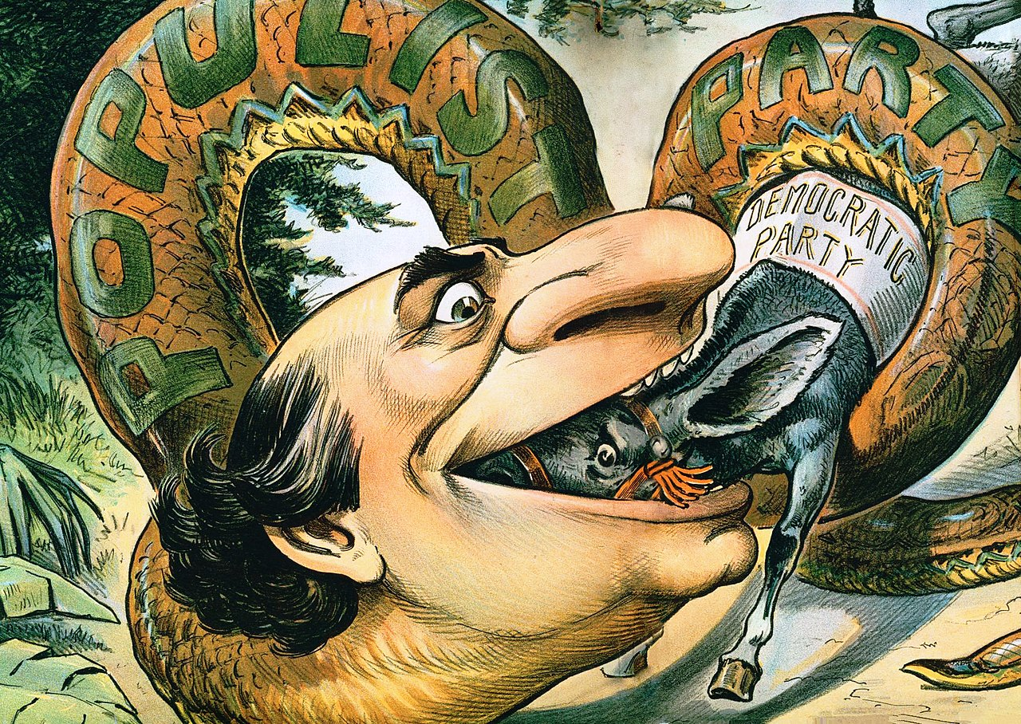
Anti Bryan cartoon

Slide 7
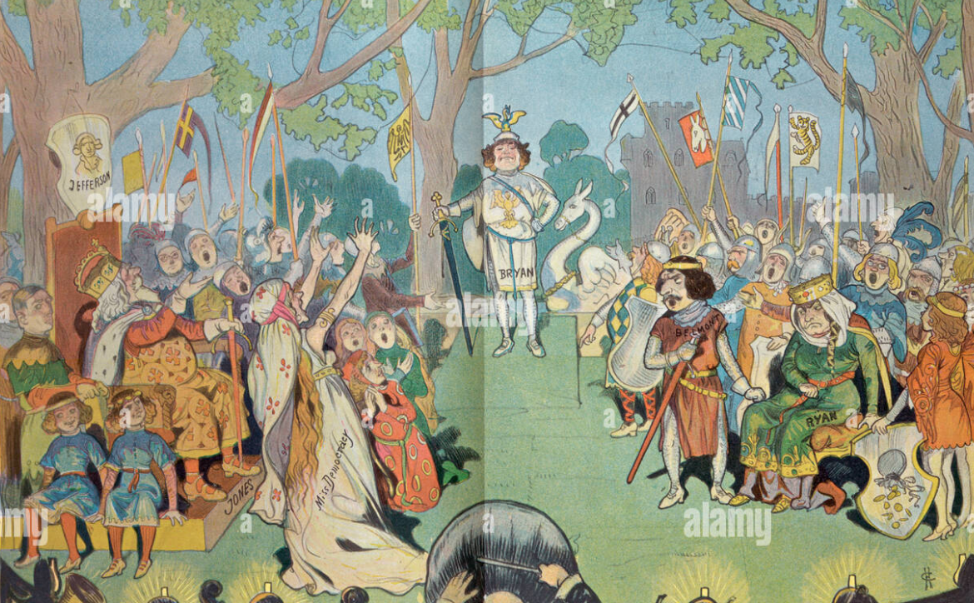
Anti Bryan cartoon….ridicule new “prince”

Slide 8
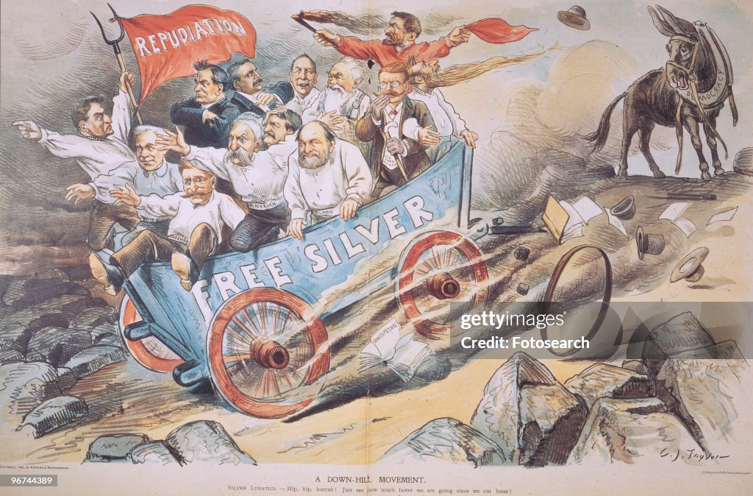
Anti Bryan Cartoon…leading country to ruin

Slide 9
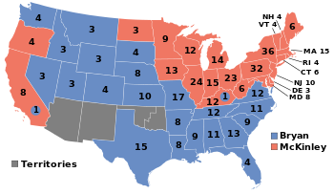
And the result
McKinley…sound money,
Conservatism Empire beat
Inflation & change
McKinley 7 million votes, 51
Bryan 6 million 47%
Democrats now party of “working man”
& Reform….and white supremacy
Republicans established as party
Of business/ sound finance & Empire
Capital has triumphed….for now
Business in control Safety, prosperity the goal ….Empire the reward

Slide 10
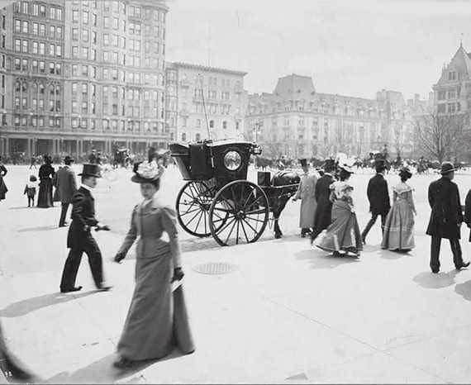
New York city 1897

Slide 11
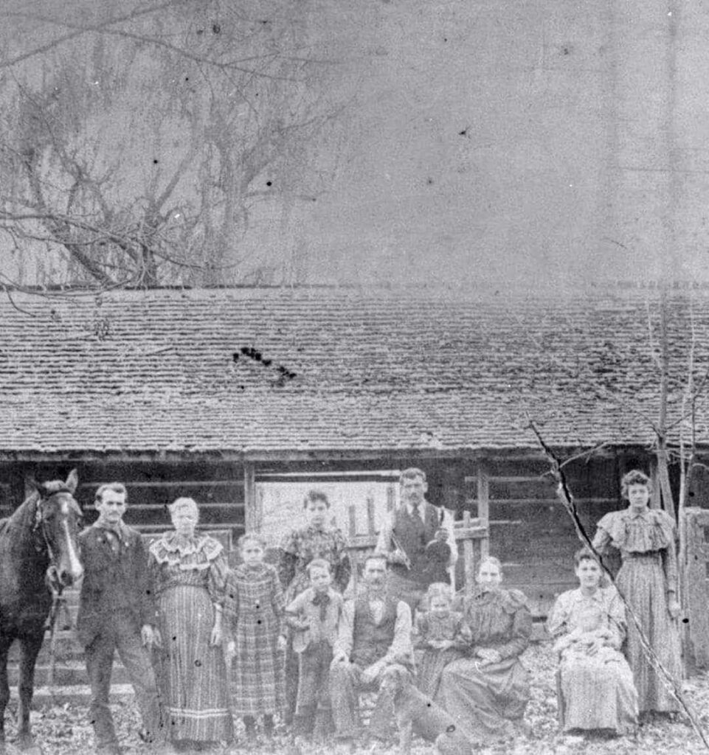
Rural life….1888

Slide 12
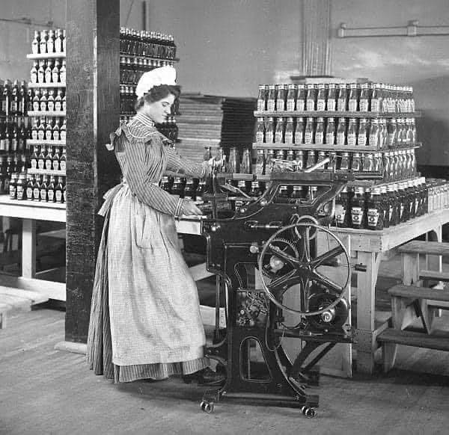
Women at work: bottling factory 1897

Slide 13
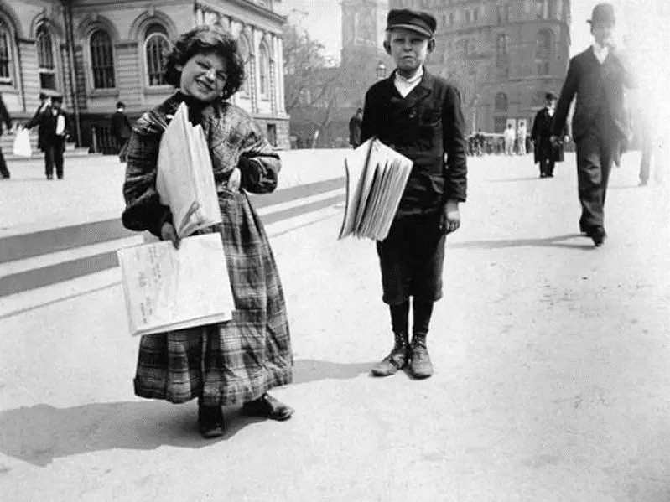
“Newsies”….1897

Slide 14
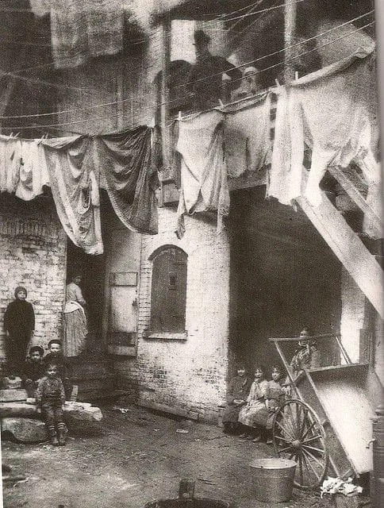
New York slums… 1898

Slide 15
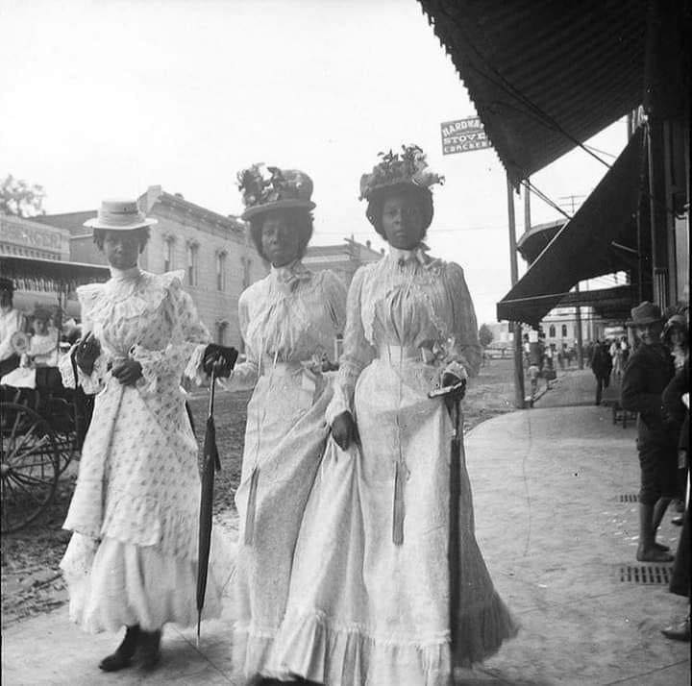
Strolling through Marshall Texas 1899

Slide 16
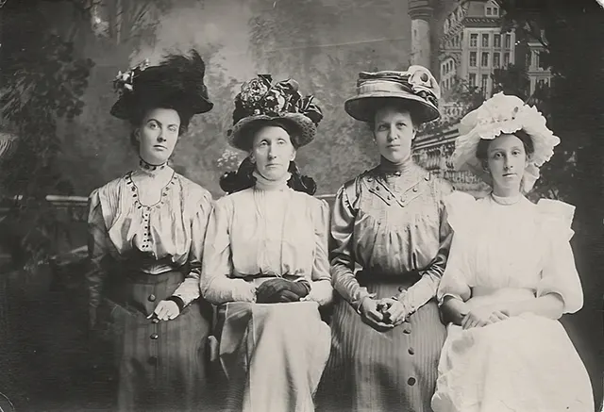
Ladies of fashion

Slide 17
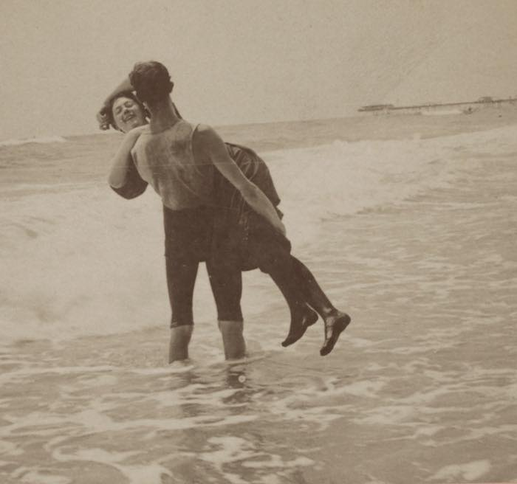
By the beach 1897 (“Say that again and I’ll dip you”)

Slide 18
America 1896…..Optimistic, invincible, prosperous…ready to grab its place in the world…..how….subject of next talk.

